Slide 1
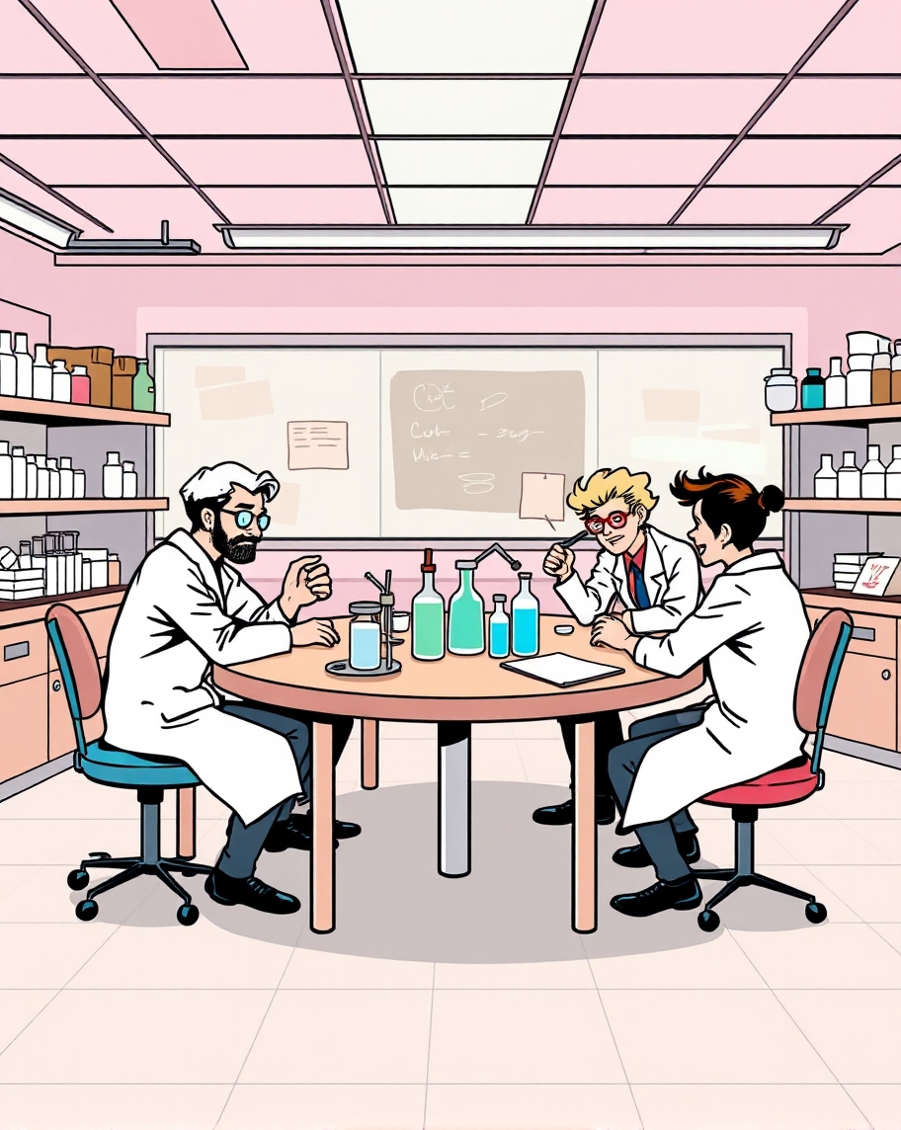
These epidemiologists, it takes them 2h and a fancy computer to tell you what you already know
I told you that 400 cows would be OK!
Yeah, epidemiology is the science of making the obvious obscure!

